Slide 1




Navttc (PMYSD) Batch (lll) Advance Web Application Development

Slide 2
Today php Topics
Introduction to php
What is XAMPP
How to Downlaod and install php & XAMPP
Complete php programming in one Shot

Slide 3
What is PHP?
PHP stands for Hypertext Preprocessor. It is a server-side scripting language used to create dynamic websites and web applications.
PHP code runs on the web server, and the result is sent to the user's web browser as HTML.
PHP is widely used for web development and works easily with databases like MySQL.

Slide 4
Key Features of PHP
PHP is open-source and free to use.
It is a server-side language.
PHP can be embedded inside HTML.
It supports many databases like MySQL, Oracle, and PostgreSQL.
PHP is easy to learn and flexible.
It runs on different platforms such as Windows, Linux, and macOS.

Slide 5
How PHP Works
The user sends a request from the browser.
The request goes to the web server.
The server executes the PHP code.
PHP generates HTML output.
The browser displays the result to the user.
<?php echo "Hello World"; ?>

Slide 6
What is XAMPP?
XAMPP is a local server software package that allows developers to run PHP and databases on their computer.
It provides an easy way to create a local web development environment without installing each component separately.
XAMPP is commonly used for testing and developing websites locally before deploying them online.

Slide 7
Components of XAMPP
XAMPP stands for:
X – Cross Platform A – Apache Web Server M – MySQL / MariaDB Database P – PHP P – Perl

Slide 8
Main Components Explained
Apache Apache is a web server that handles requests from the browser and serves web pages.
MySQL / MariaDB It is a database system used to store and manage website data.
PHP A scripting language used to build dynamic web pages.
Perl A programming language used for scripting and system administration tasks.

Slide 9
Why We Use XAMPP
Easy to install and configure
Free and open source
Allows local website development
Includes all required tools in one package
Helpful for testing web applications

Slide 10
PHP vs JavaScript
PHP | JavaScript
Server-side language | Client-side language
Runs on the web server | Runs in the browser
Used for backend development | Used for frontend development

Slide 11
Advantages of PHP
Simple and easy to learn
Large community support
Compatible with many databases
Works on different operating systems
Widely used in web development

Slide 12
Programing language
What is program
Main Parts of programing language
Variables
Operators
Inputs
Output Statement
Control structure
Sequential
Selection(conditionals)
Iteration (Loops)
Function
Arrays

Slide 13
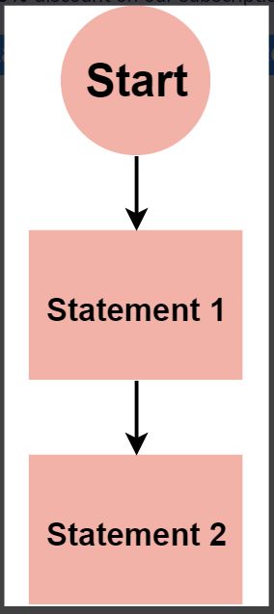
Sequential
The most basic control flow is sequential control flow. It involves the execution of code statements one after the other. A real-world example is following a cooking recipe.

Slide 14
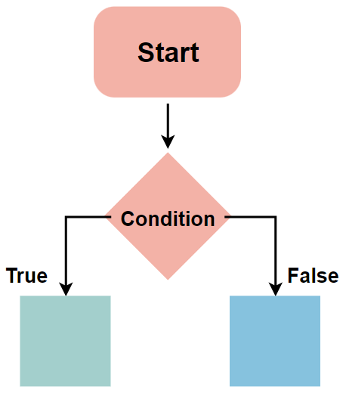
Selection (conditionals)
In the condition statement Execute the statement or set of statement on the base of condition .If the condition is true control move the first side and execute the first statement otherwise it move second side and execute other side statements
If
Ifelse
Multiple ifelse
Nested ifelse
Switch

Slide 15
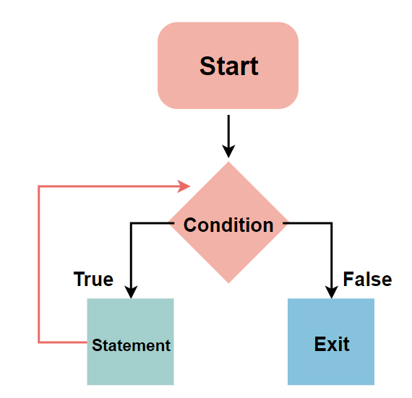
Iteration (Loops)
A loop is a programming structure that allows a statement or block of code to be run repeatedly until a specified condition is remain true.
For loop
While loop
Do while loop

Slide 16
Functions
A function is a block of organized, reusable code that is used to perform a single, related action.
Advantage
It makes our code short .
Reusable.
Time saving.
function to sum of two numbers
// Function returning sum
function myfunction($math, $english, $computer){
return $math + $english + $computer;
}
$value = myfunction(90,85,88);
echo $value;

Slide 17
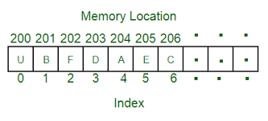
What is Array
An array is a collection of elements of the same type placed in contiguous memory locations that can be individually referenced by using an index to a unique identifier.
<?php $cars = ["mehran","civic","sonata"];
echo $cars[1];
?>

Slide 18
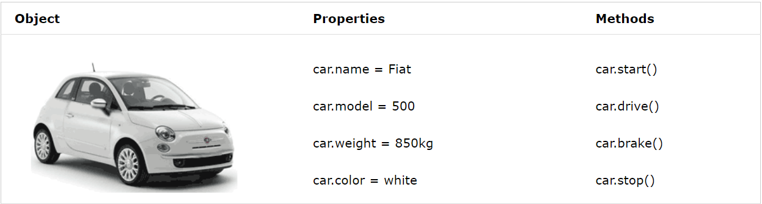
What is Object
Object is any thing about which we collect data .
Example. Ali, car, home

Slide 19
THANK YOU

